Slide 1
AGI Week-1 presentation

Slide 2
Topics:-
Emergent properties
Mental causation via Neuroprosthetics
Markov Blankets of life

Slide 3
Emergent Properties

Slide 4
Type 1
Also called Simple Emergence.
Formed by the union of individual components, i.e., single to many
Fixed role for each component and there wont be emergent property in the absence of component.

Slide 5
Component1
Component2
Component3
Component4

Slide 6
Applications:-
Problems that can be solved by dividing the problem into subtask and the solution is the union of sub solutions.
Ex:- solving Rubik’s-Cube, Path finding Puzzles etc..
Implemented using Reinforcement learning

Slide 7
Type - 2
Also called as Weak Emergence
Feedback will be present i.e., Information is passed from one level to other and feedback is received in return.
Based on the feedback current state updates.

Slide 8
Applications:-
Problems with Trail and Error based type, where the error can be corrected after getting useful information through trailing.
Ex:-Artificial Neural Networks where weights of previous level are corrected by feedback from the forward levels through back propagation

Slide 9
Type - 3
Multiple Emergence with many feedbacks(+ve , -ve).
Combination of Blind go and careful observation.
More efficient than previous.
Two types of feedback loops
Open and closed

Slide 10
Applications:-
To create a Chess Engine.
Automatic Driving.

Slide 11
Type - 4
Also known as Strong Emergence
Irreducible, No backtracking i.e., current state cant be degraded to previous
Cant identify this type of behaviour promptly.
Like culture, cell division

Slide 12
Applications:-
Solving Problems using Hill climbing algorithm, to reach goal

Slide 13
Mental Causation via Neuroprosthetics

Slide 14
Keywords
Mental State:- The state of the mind like happy, angry etc…
Neural State:- Pattern of the brain region
Neuroprosthetics:- study of Establishing relationship between brain and Computer
Multiple Realisation:- Same mental state can be achieved through different events
https://www.google.com/search?q=neural+state+meaning

Slide 15
Lets neural state N is only responsible behaviour B with Mental state M then we can say as (N => B) and (~N => ~B), Also (M => B) and (~M => ~B). So we can say Mental and physical are same
If we consider Multiple realisation, then A mental state can be realised by two different neural states which conflicts the statement “Mental and physical are Same”.
C:\Users\KADIRI MOHAN KUMAR\Downloads\Image 2.png

Slide 16
Multiple realisation
M --------------N------------------ B
/ \
/ \
N1 N2
"C:\Users\KADIRI MOHAN KUMAR\Downloads\Image 3.png"

Slide 17
Markov Blankets of Life

Slide 18
Key Points:-
Markov Blanket: - A Markov Blanket of a system is considered as the boundary of the System. It is the division of system into external and internal states.
Markov Blanket itself consists of Two states, active and sensory.
"C:\Users\KADIRI MOHAN KUMAR\Downloads\Image 5.png"
Existence of Markov Blanket means external states are conditionally independent of internal states in presence of active and sensory states.

Slide 19
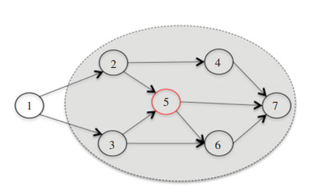
Markov Blanket
Markov Blanket(node) = {parents(node)} U {children(node)} U {other parents(node)}
From figure, Markov Blanket(5) = {2,3} U {6,7} U {3,4} = {2,3,4,6,7}
So to know the information of state5 we just need {2,3,4,6,7}.

Slide 20
Markov Blanket of Blankets
Each Markov blanket itself have a Markov Blanket
Like group of Cells form tissue and group of tissues into organ

Slide 21
Emergence with Markov Blanket
Habits Adapted and taught by previous generations

Slide 22


